Slide 1


University Graduation Project
Legacy of Legends: Khalid Ibn Al-Waleed
B.Sc. Thesis By
Mohammad Al-Rawas
USKUDAR UNIVERSITY  FACULTY OF ENGINEERING AND NATURAL SCIENCES

Slide 2
Table of Contents
1- Introduction
- Game Brief | Objectives | Project Scope | Feasibility Study
2- Methodology
- Scrum Framework | Product Backlog
3- System Design
- Use-Case Diagram
4- Implementation
- Menus | Gameplay
5- Conclusion
- Game Summary | Future Work | Game Demonstration

Slide 3

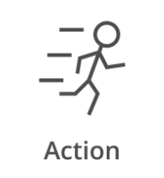
Introduction
Game Brief
"Legacy Of Legends: Khalid Ibn Al-Waleed "
An immersive RPG game that follows the legendary life of Khalid Ibn Al-Waleed, a renowned military commander of the Islamic world. Players will navigate through pivotal moments of Khalid's life, from his early days as a fierce warrior to his strategic brilliance in leading conquests. With dynamic combat systems, intricate political manoeuvres, and moral dilemmas, players will experience the challenges and triumphs of one of history's greatest military leaders!

Slide 4
Introduction
Objectives
Blending immersive gameplay with rich, narrative-driven storytelling, this game invites players into the epic life of Khalid Ibn Al-Waleed. Experience his transformation from a fierce warrior to a legendary commander of the Islamic world. Engage in pivotal battles, strategic conquests, and deeply personal moments that shaped history. The game brings to life an era often overlooked in gaming, with authenticity and depth. It’s more than just a game—it’s a tribute to one of history’s greatest military leaders.

Slide 5
Introduction
Project Scope
Main Menu:
Play
Chapter Selection
Settings
Quit
Gameplay:
Travelling System
Combat System
Quest System
Cutscenes

Slide 6
Introduction
Feasibility Study
Table 1: Hardware
Table 2: Software
Category | Minimum | Price
Operating System | Windows 10 | Available
Processor | 3.4 Hz | Available
Memory | 16 GB RAM | Available
Graphics Card | Any DirectX 11compatible card | Available
Storage | 100 GB | Available
Power Supply | 1000 W | Available
Name | Description | Price
Unreal Engine 5 | Game Engine | Free
Epic Marketplace | Assets Store | 300$-500$ (All Assets)
Visual Studio Code | IDE | Free
GitHub | Source Control | Free
Blender | 3D Modelling | Free
Marvelous | Cloth Designer | 100$/Month
WorldMachine | Map Generator | Free
Substance 3D | Material Designer | Free
Audacity | Audio | Free

Slide 7
Methodology
Scrum Framework
Scrum is an adaptable agile framework that is used in project management, primarily in software development, to improve collaboration, productivity, and flexibility. It enables teams to be flexible, adapt to changing requirements, and deliver high-quality products faster, making it popular in dynamic project environments.

Slide 8
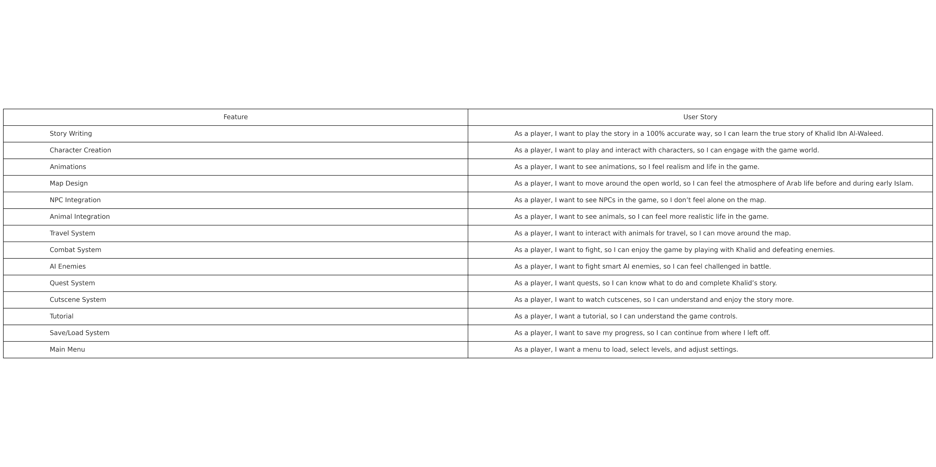
Methodology
Product Backlog
Table 3: Product Backlog

Slide 9
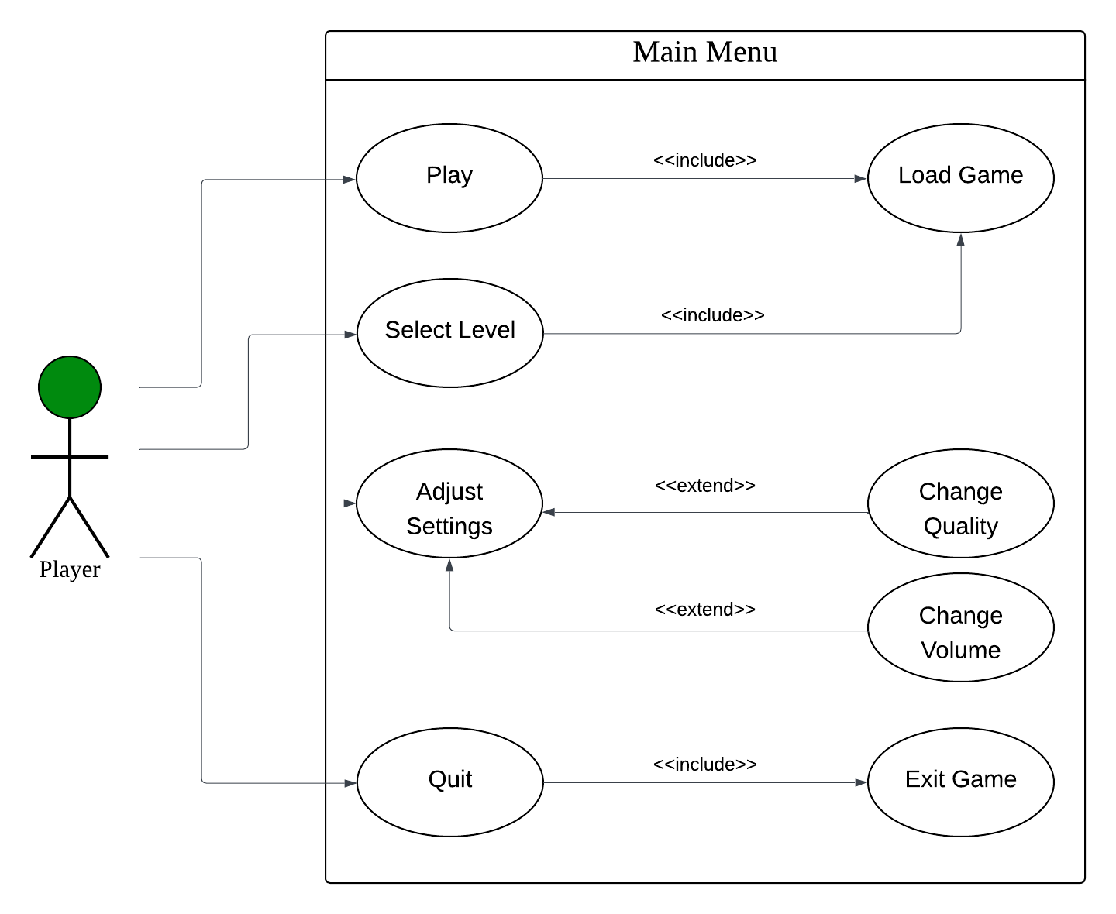
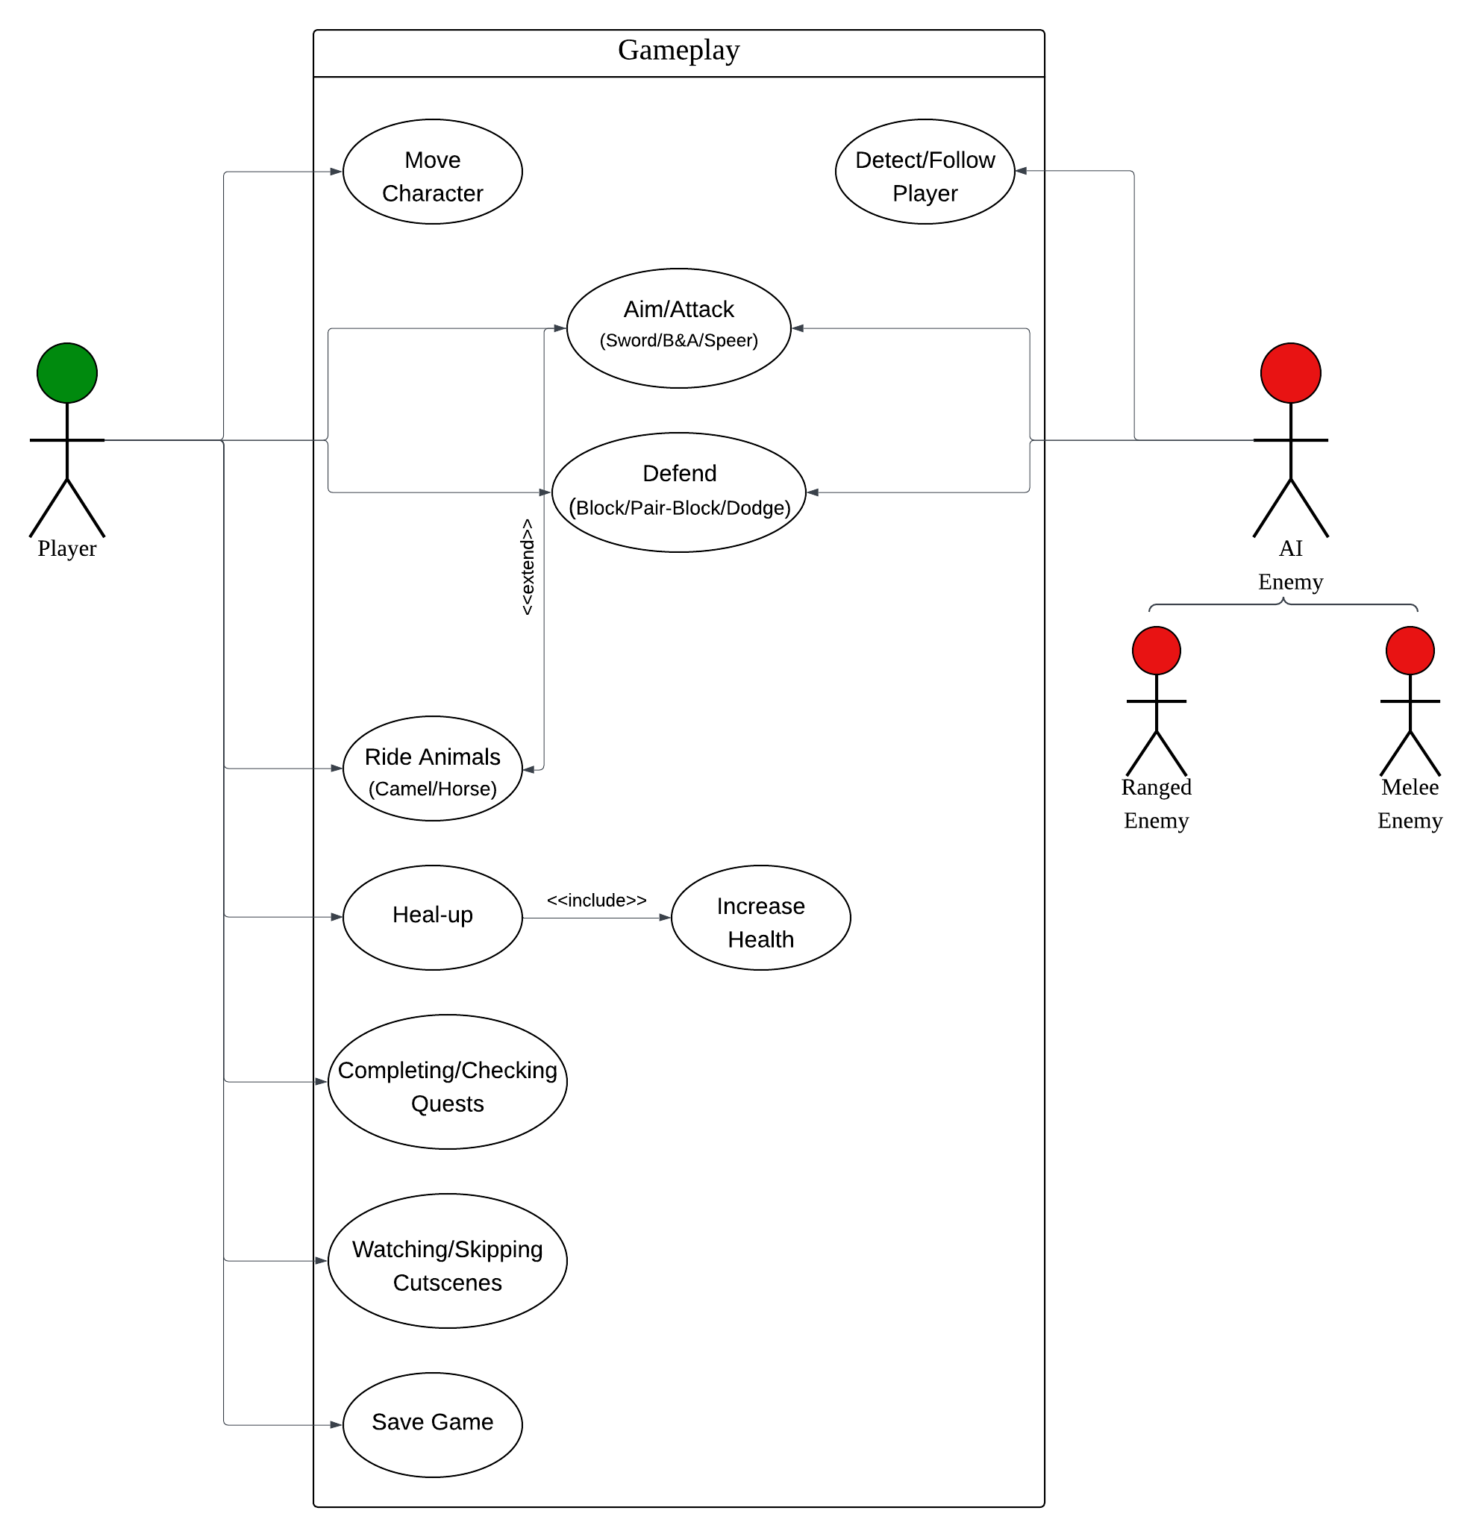
System Design
Use-Case Diagram
Figure 1: USD-Main Menu
Figure 2: USD-Gameplay

Slide 10
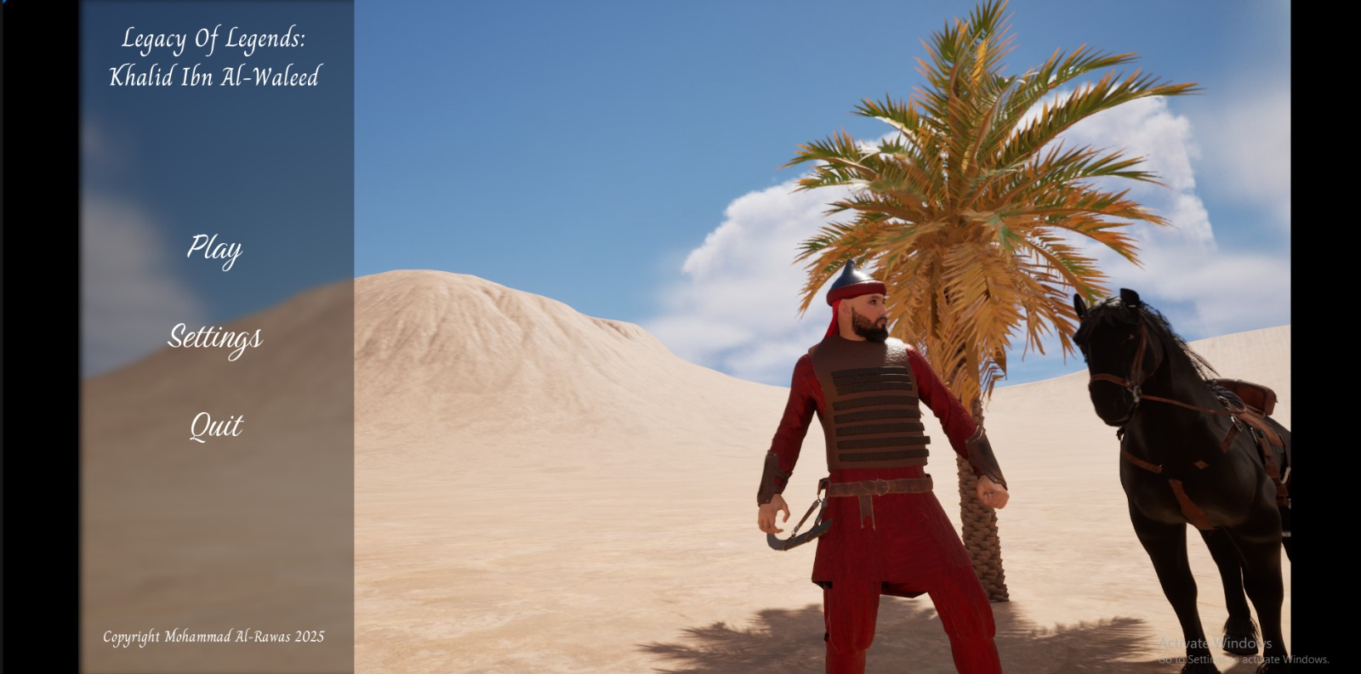
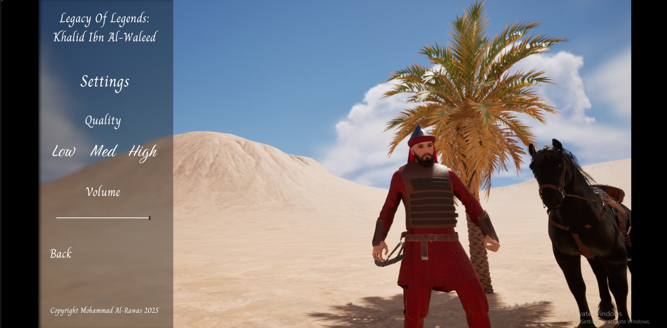
Implementation
Menus
Figure 3: Main Menu
Figure 4: Settings Menu

Slide 11
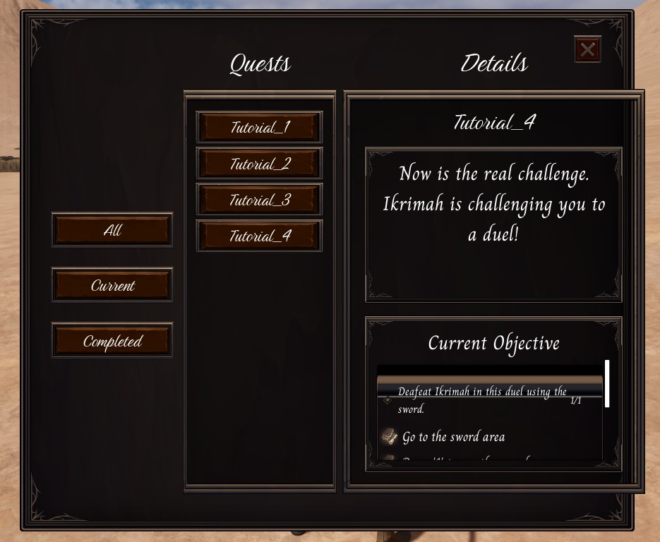
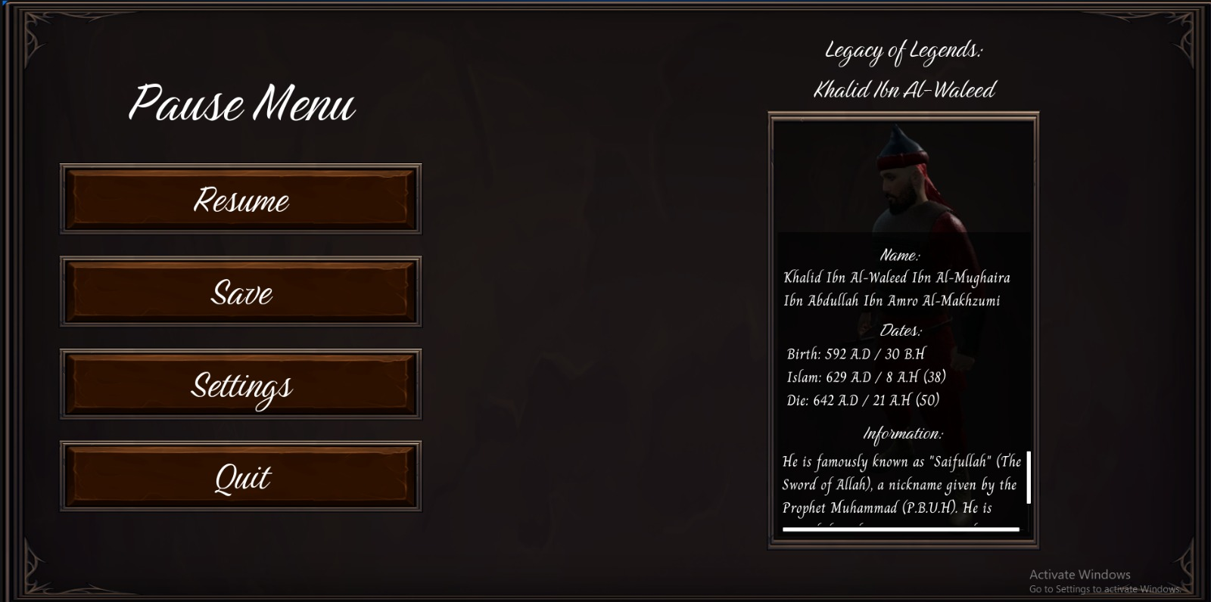
Implementation
Menus
Figure 5: Quest List Menu
Figure 6: Pause Menu

Slide 12
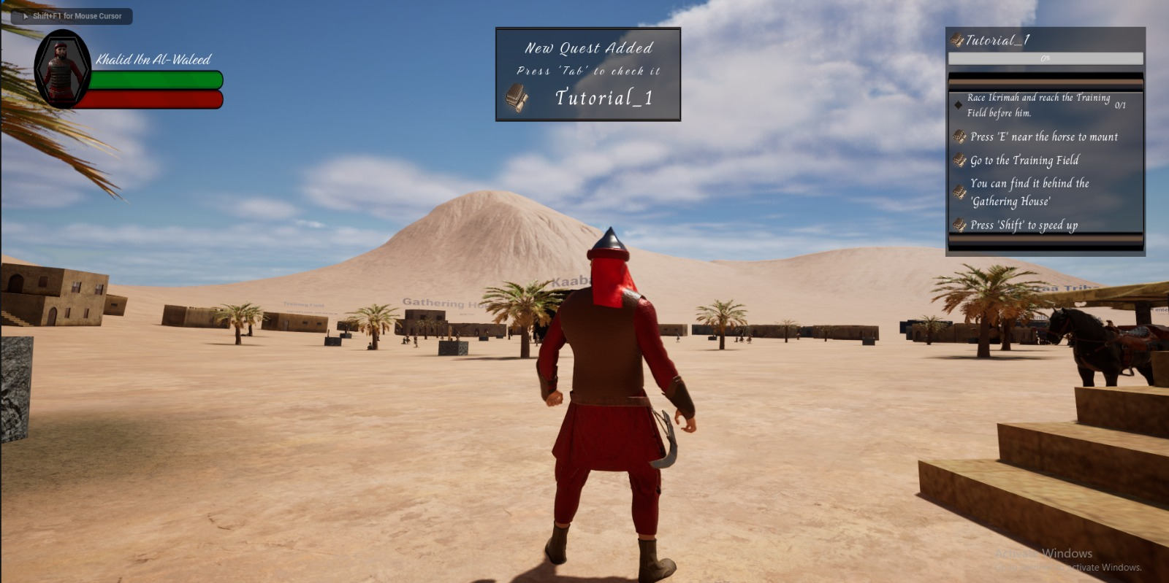
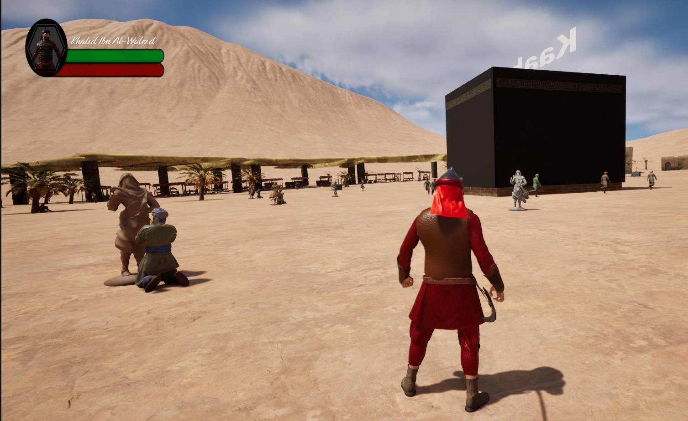
Implementation
Gameplay
Figure 7: In-Game 1
Figure 8: In-Game 2

Slide 13
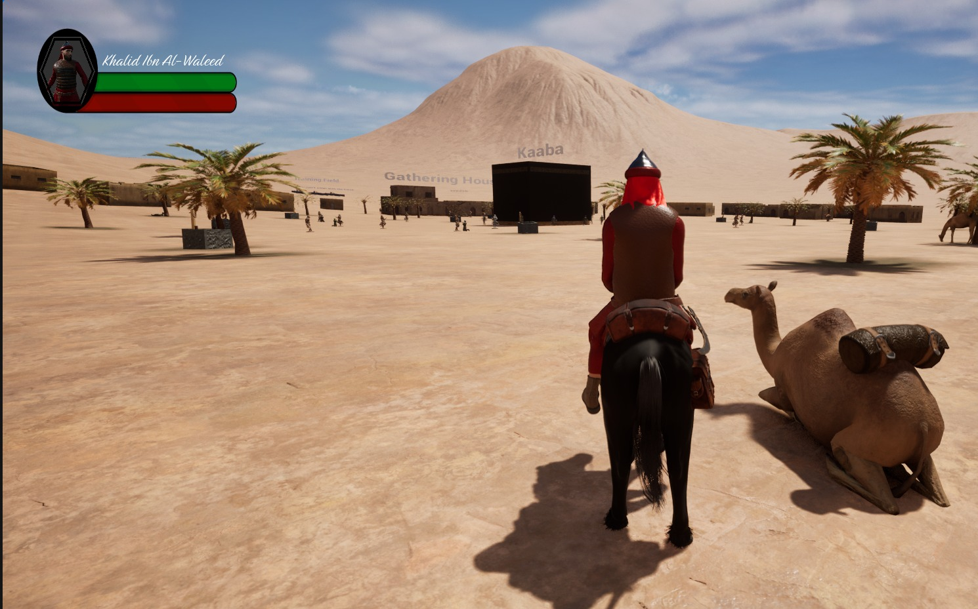
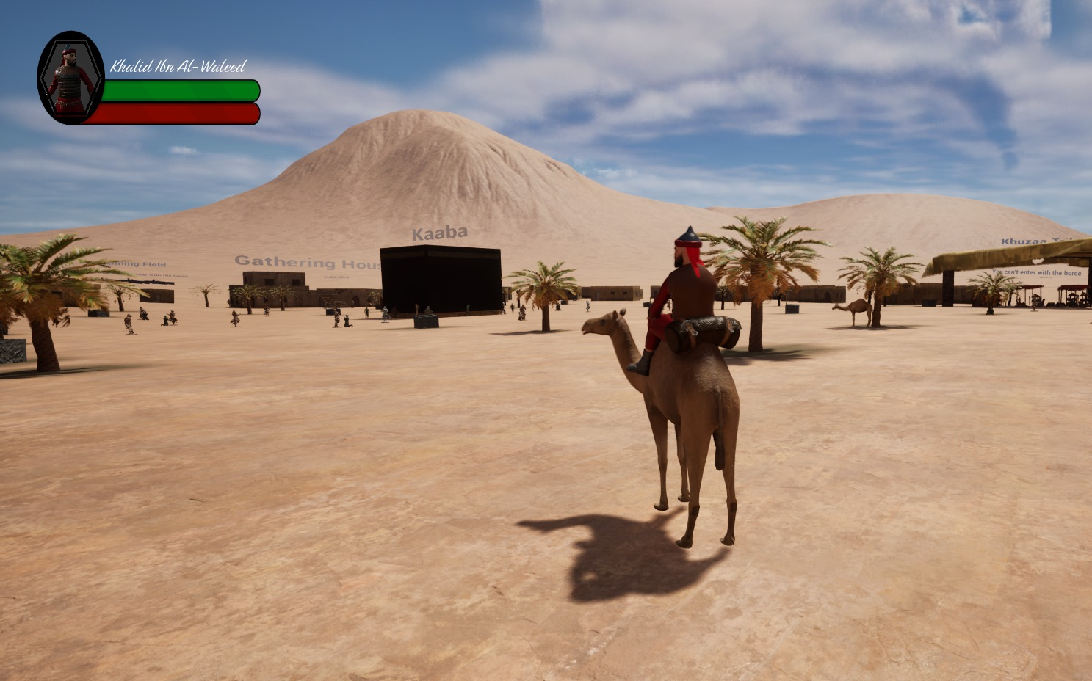
Implementation
Gameplay
Figure 9: Horse Riding System
Figure 10: Camel Riding System

Slide 14
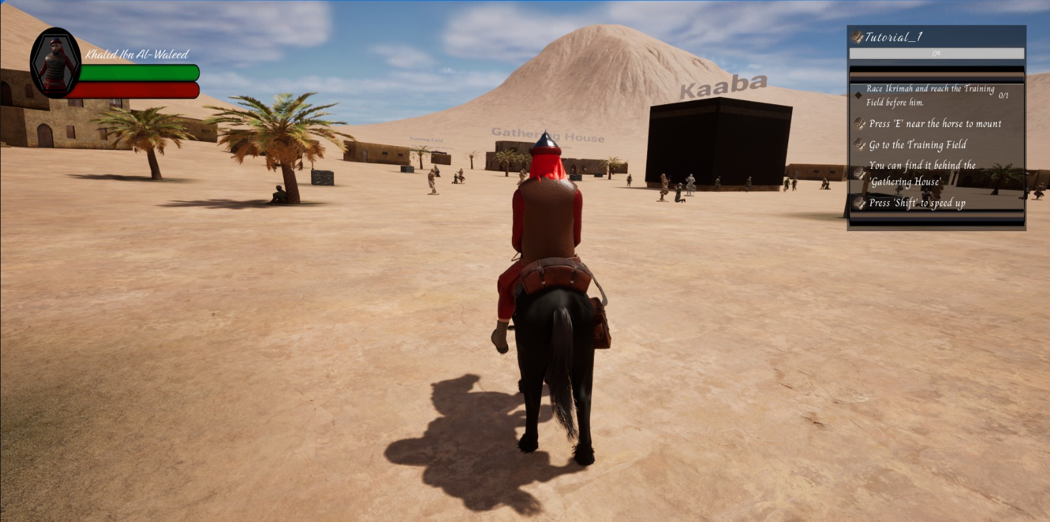
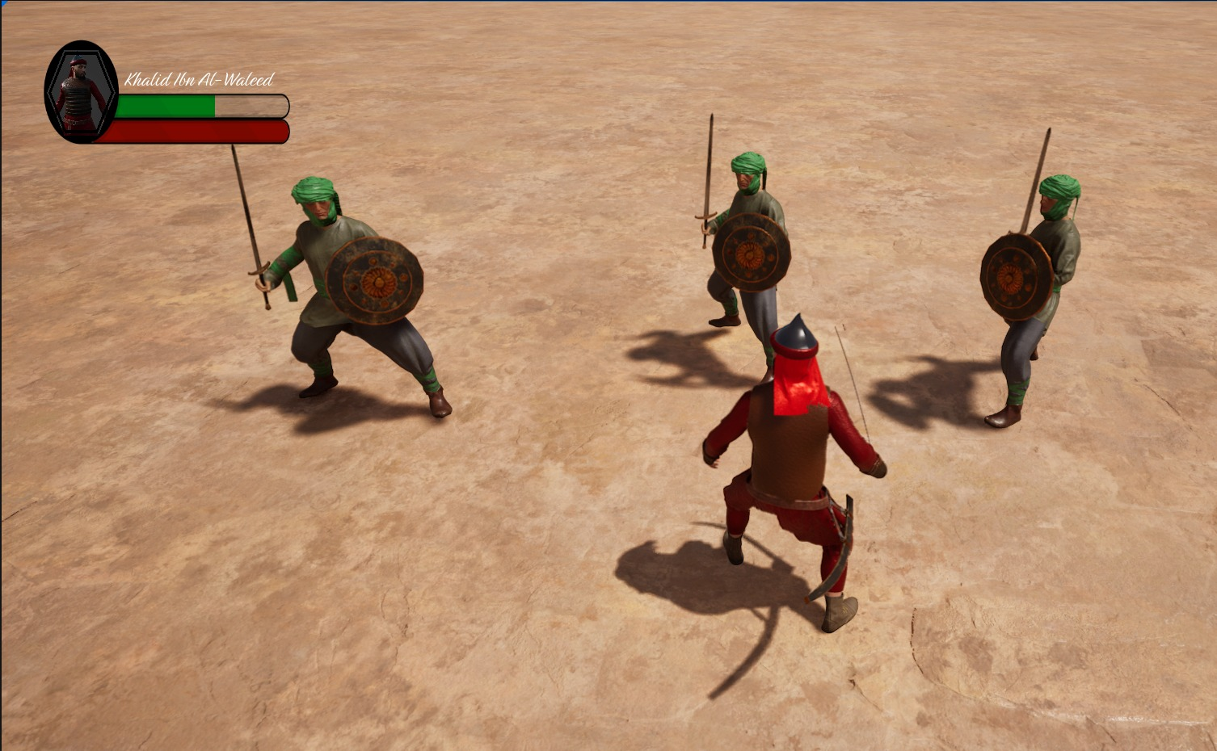
Implementation
Gameplay
Figure 11: Location-Based Quest
Figure 12: Combat-Based Quest

Slide 15
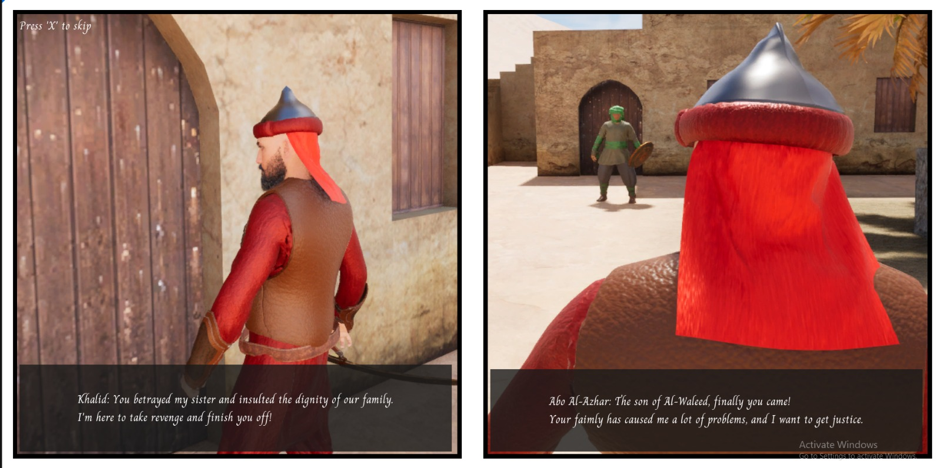
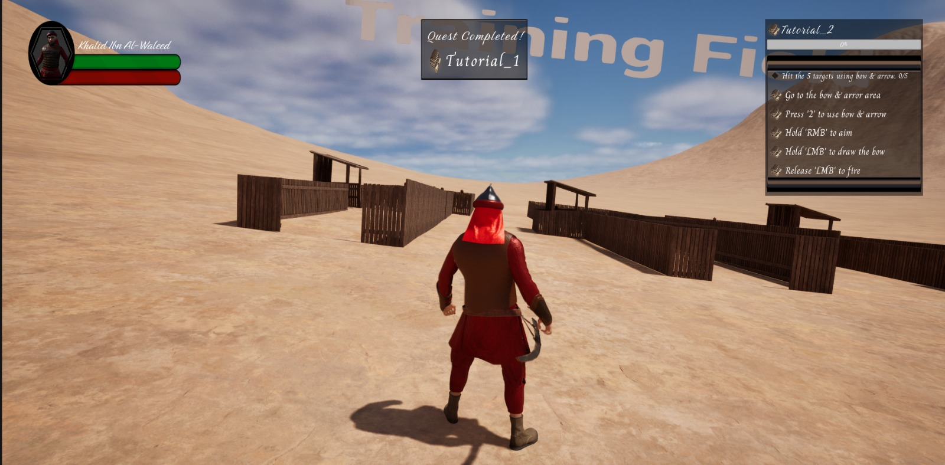
Implementation
Gameplay
Figure 13: Cutscene
Figure 14: Quest Completed Notification

Slide 16
Conclusion
Game Summary
It is an RPG game about the life-story of Khalid Ibn Al-Waleed.
It was made by Unreal Engine, and the purpose of the game is to teach the new generation about the historical life of one of the greatest commanders ever and have the chance to play and experience his legendary career.
To complete the game you, have to do the required quests whether it is location-based or combat-based quest so you can experience the correct story of our legendary hero.

Slide 17
Conclusion
Future Work
- Continue working on the game until I finish all chapters
- Improve the map to have better experiences
- Add more NPCs to bring more life to the game
- Adding select level function
- Adding save/load functions
- Improving the cutscenes
- Adding more languages like Arabic and Turkish
- Deploy and build the game so it can be ready to download on steam or itch.io

Slide 18
Conclusion
Game Demonstration
Game Implementation: https://youtu.be/yCRHOFl4Ndg
Game Walkthrough : https://youtu.be/TzKIasijPR4

Slide 19
University Graduation Project
Thank You!
USKUDAR UNIVERSITY  FACULTY OF ENGINEERING AND NATURAL SCIENCES

